Slide 1




Chapter 10
Classification and Clustering
Group 4 - AI1801
Mentor : NhungNTH69

Slide 2




Contents
10.1 Classification
Naïve Bayes
Support Vector Machines
Evaluation

Slide 3
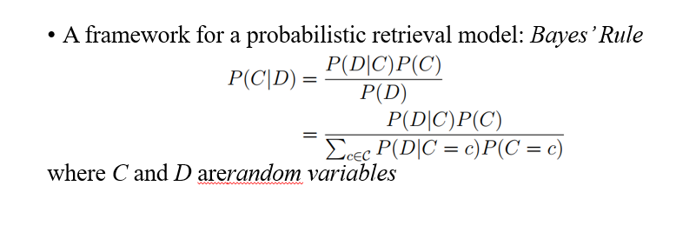
Classification: Naïve Bayes

Slide 4
Types of Naïve Bayes Classifiers:
There are several variations of Naïve Bayes classifiers based on how the likelihood P(D∣C) is modeled:
Gaussian Naïve Bayes: Assumes that continuous features follow a normal (Gaussian) distribution.
Multinomial Naïve Bayes: Commonly used for text classification, where word frequency is modeled as a multinomial distribution.
Bernoulli Naïve Bayes: Used for binary features (e.g., word presence/absence in text classification).

Slide 5
Key Applications of Naïve Bayes:
Text Classification: Spam detection, sentiment analysis, topic categorization.
Medical Diagnosis: Predicting diseases based on symptoms.
Image Recognition: Digit recognition, facial expression analysis.
Recommendation Systems: Personalized content recommendations.

Slide 6
Advantages of Naïve Bayes:
Fast and efficient: Requires minimal training data and works well with high-dimensional datasets.
Performs well with small datasets: Especially useful when there is limited training data.
Handles categorical and numerical data effectively.
Works well in real-time applications such as spam filtering and sentiment analysis.

Slide 7
Limitations of Naïve Bayes:
Strong independence assumption: In real-world data, features are often dependent on each other, which can limit accuracy.
Zero probability problem: If a feature value never appears in training for a class, the probability estimate for that class can become zero (can be addressed with Laplace smoothing).
Performs poorly with highly correlated features (e.g., features that provide redundant information).

Slide 8
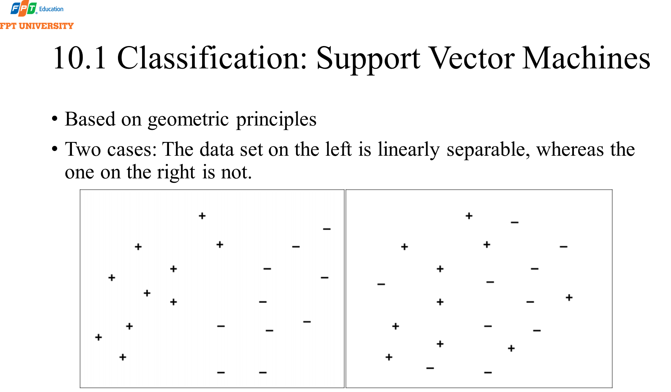

Slide 9
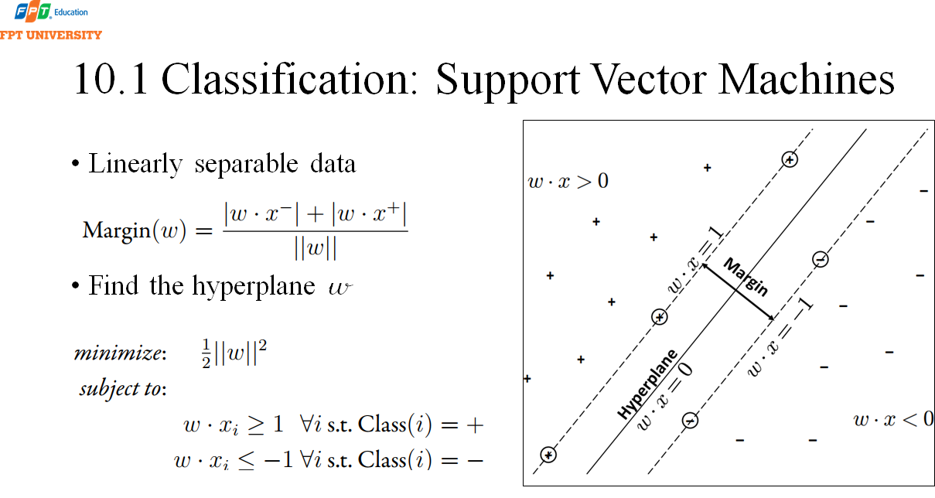

Slide 10

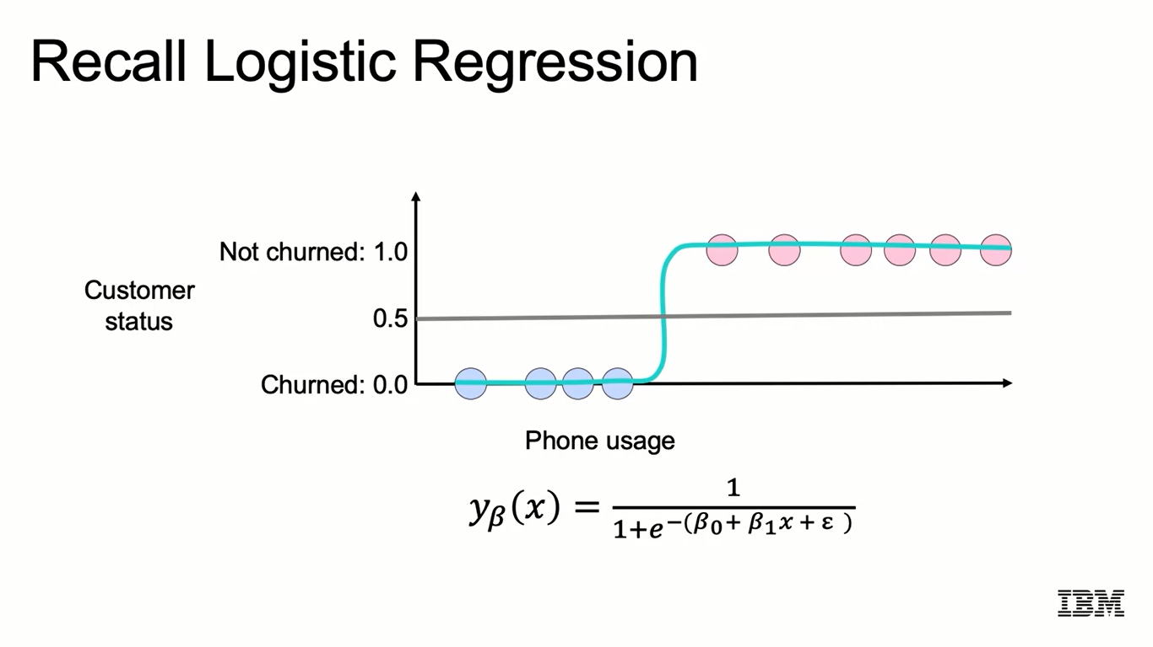
Recall Logistic Regression
9

Slide 11
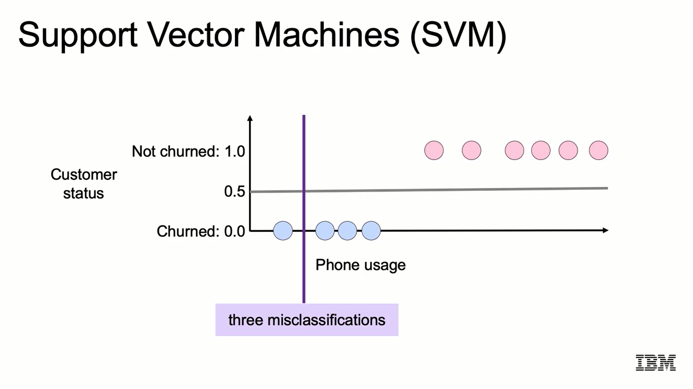
Support Vector Machines (SVM)
10

Slide 12
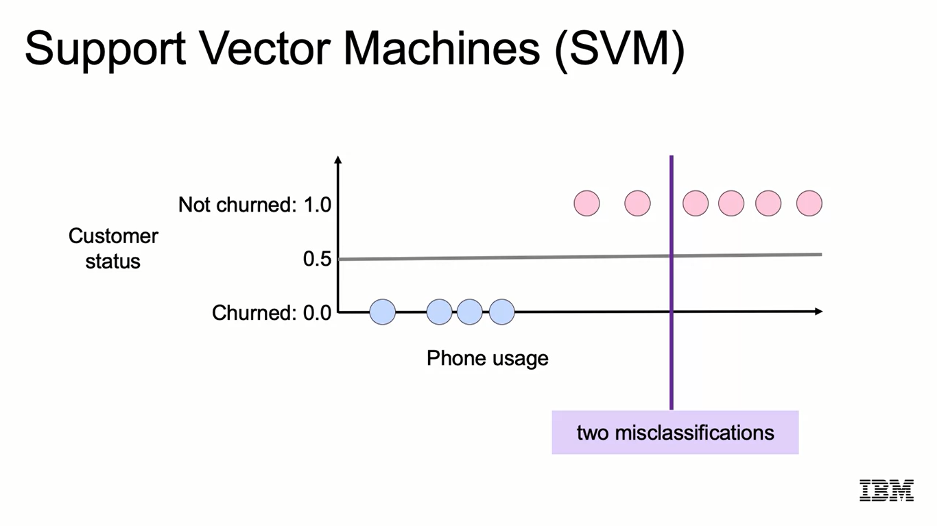
Support Vector Machines (SVM)
11

Slide 13
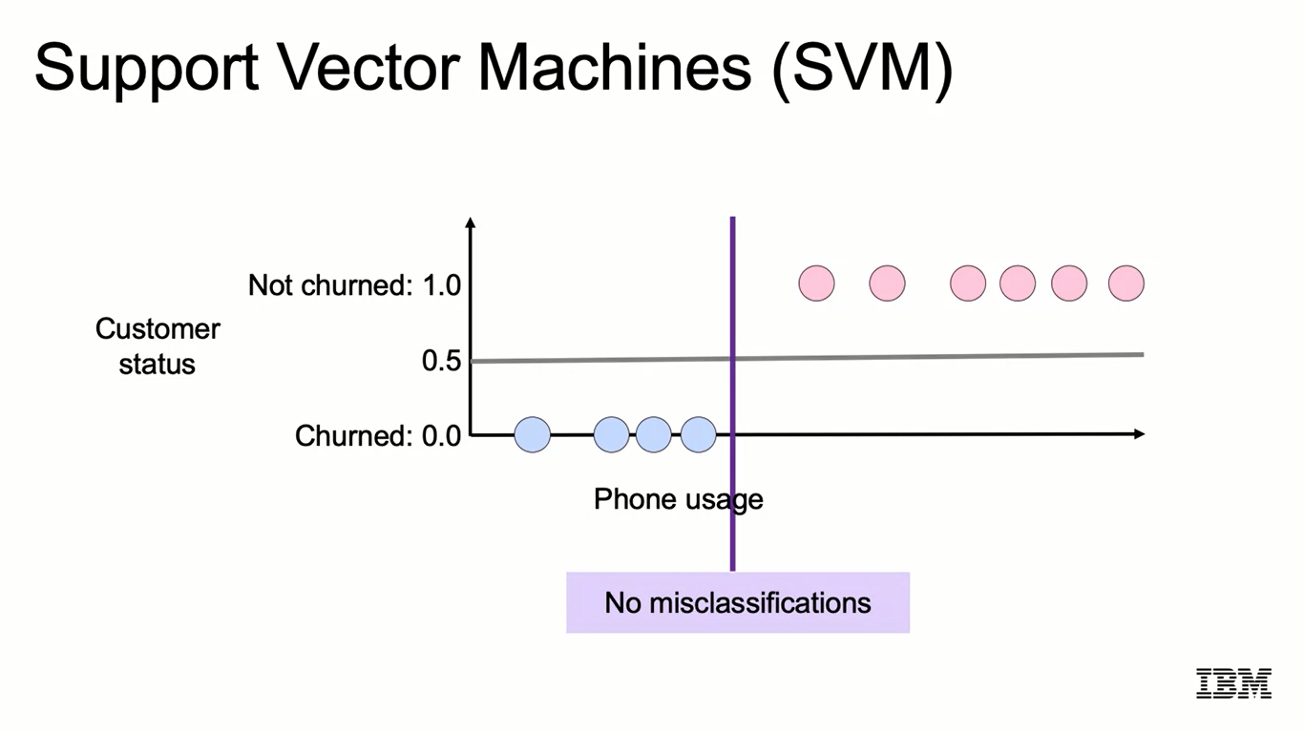
Support Vector Machines (SVM)
12

Slide 14
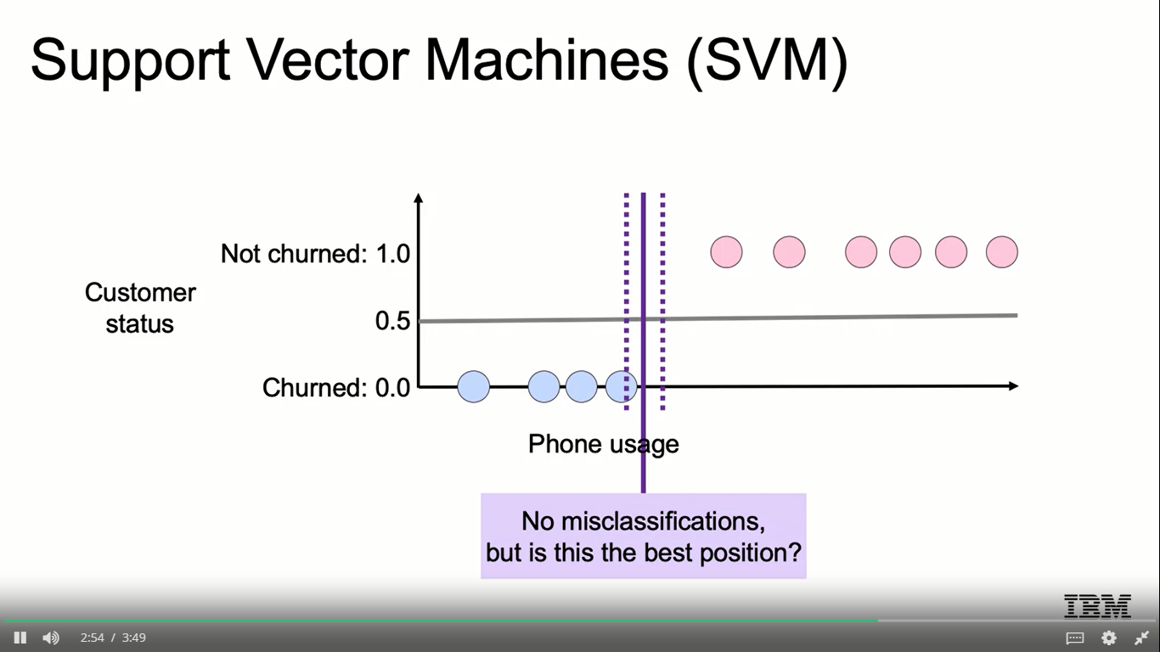
Support Vector Machines (SVM)
13

Slide 15
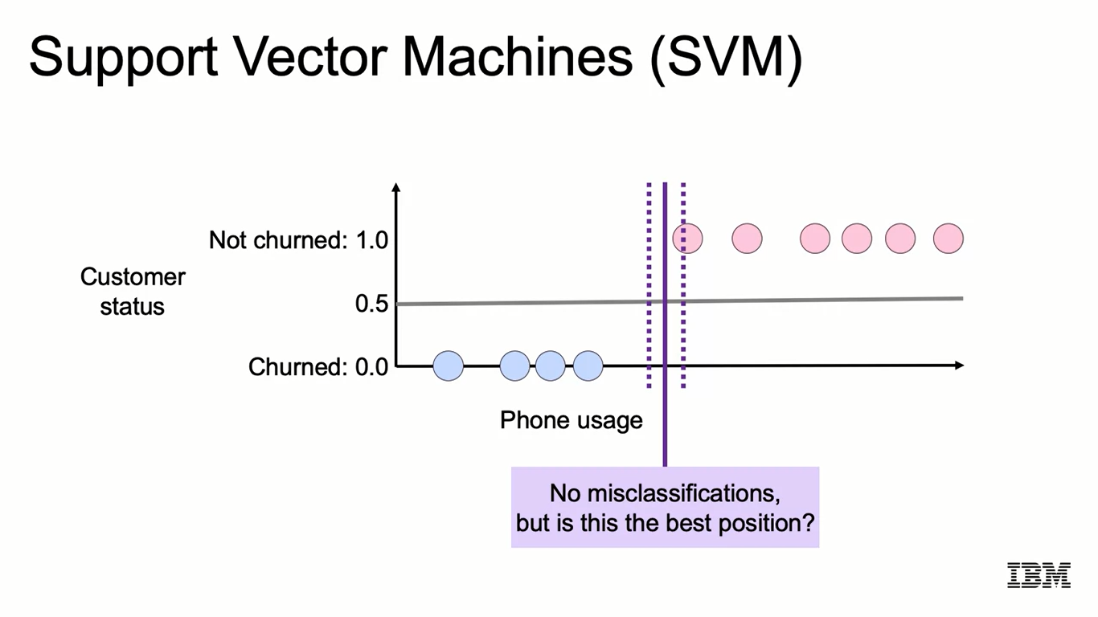
Support Vector Machines (SVM)
14

Slide 16
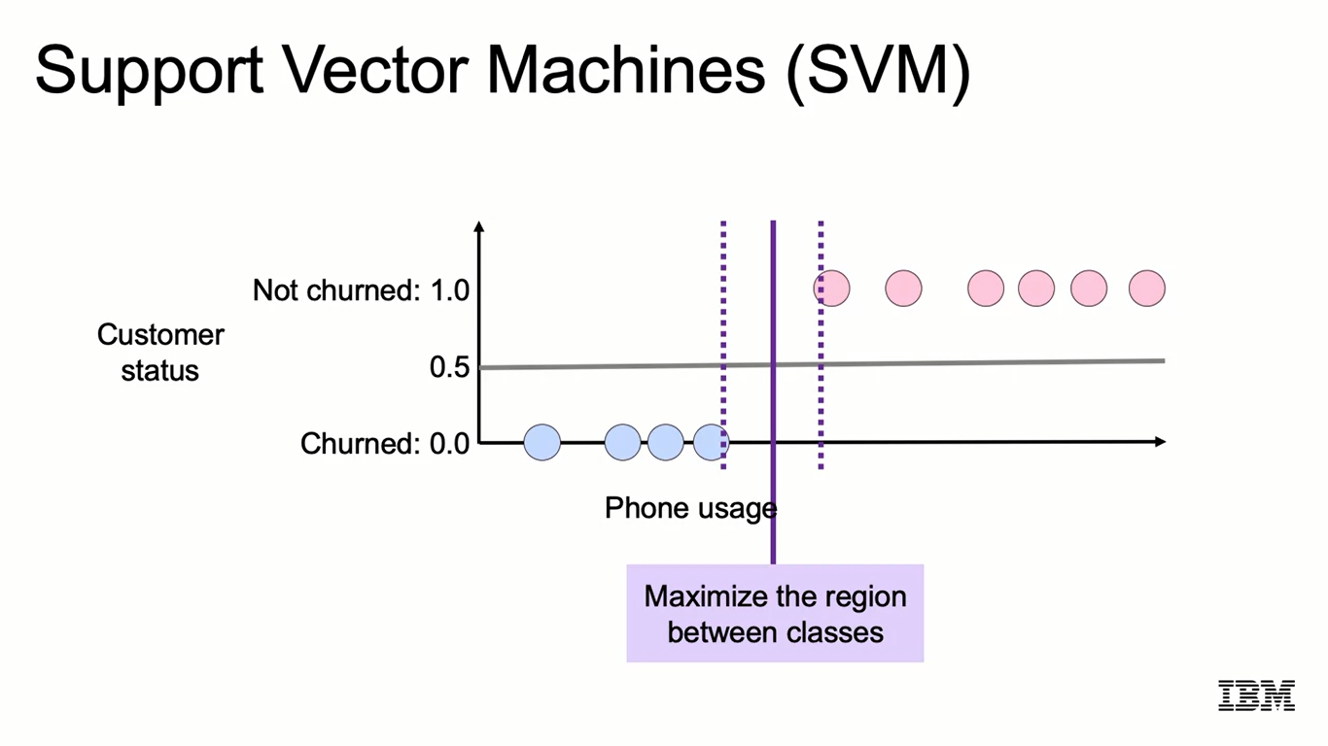
Support Vector Machines (SVM)
15

Slide 17
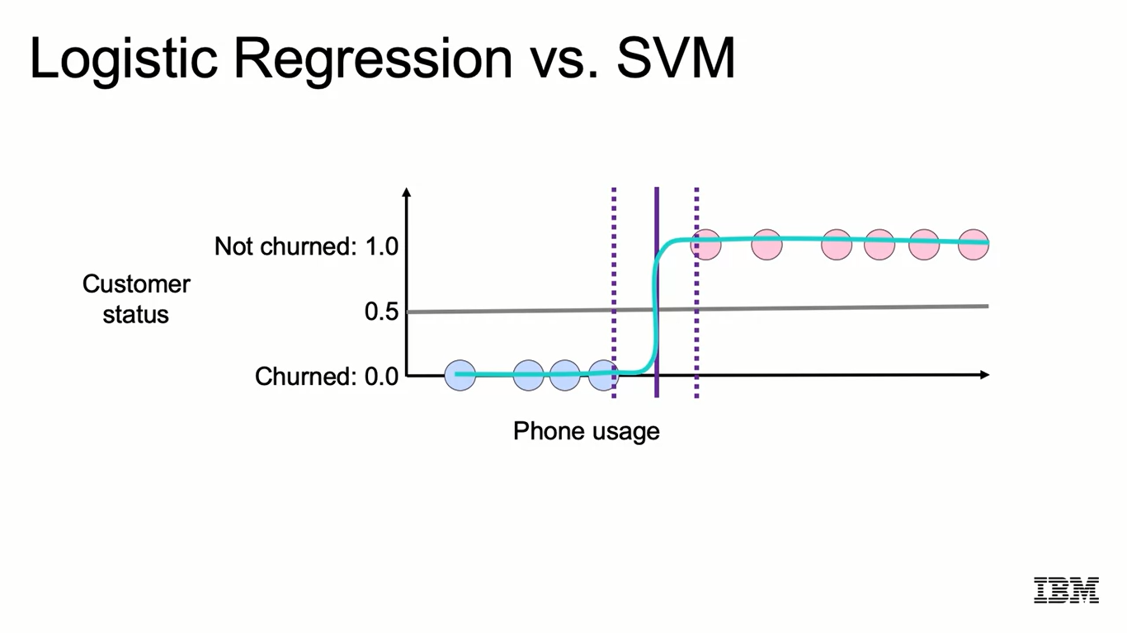
Logistic Regression vs. SVM
16

Slide 18
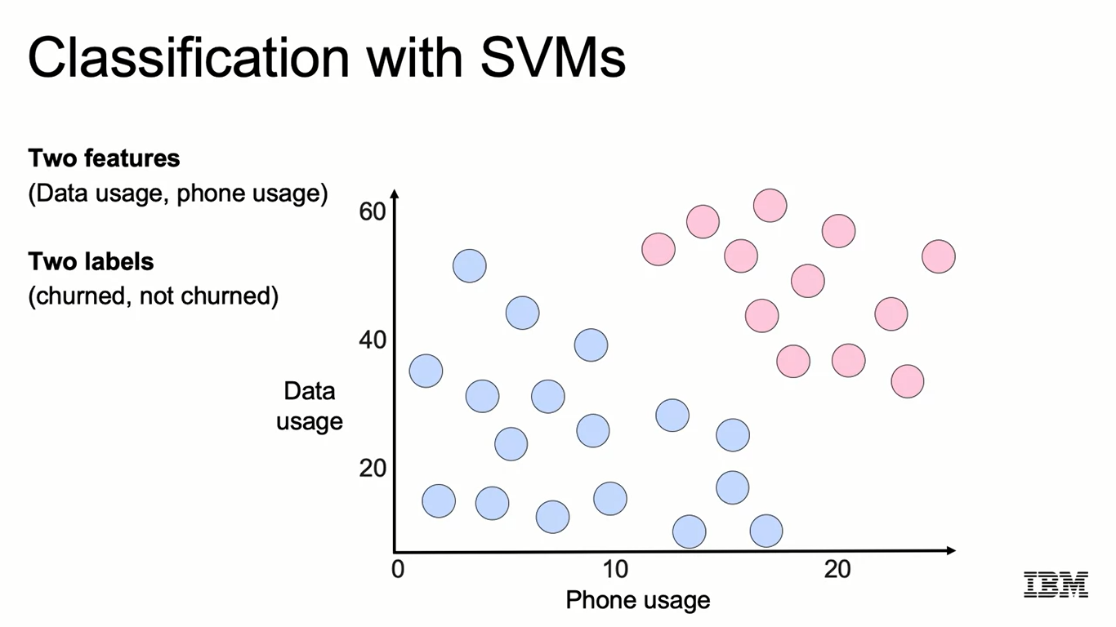
Classification with SVMs
17

Slide 19
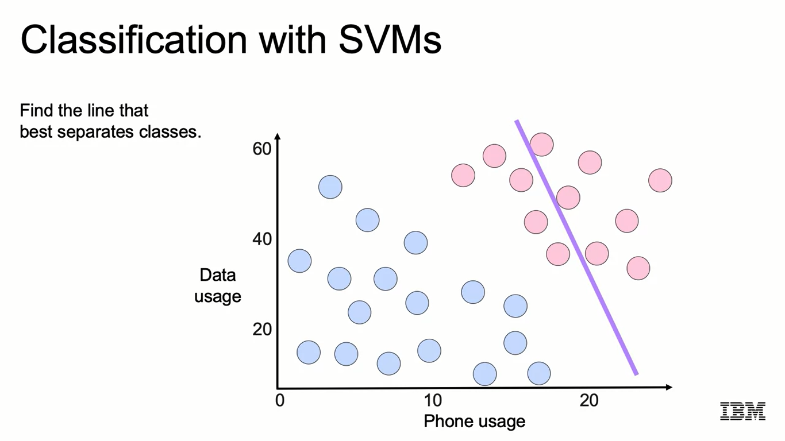
Classification with SVMs
18

Slide 20
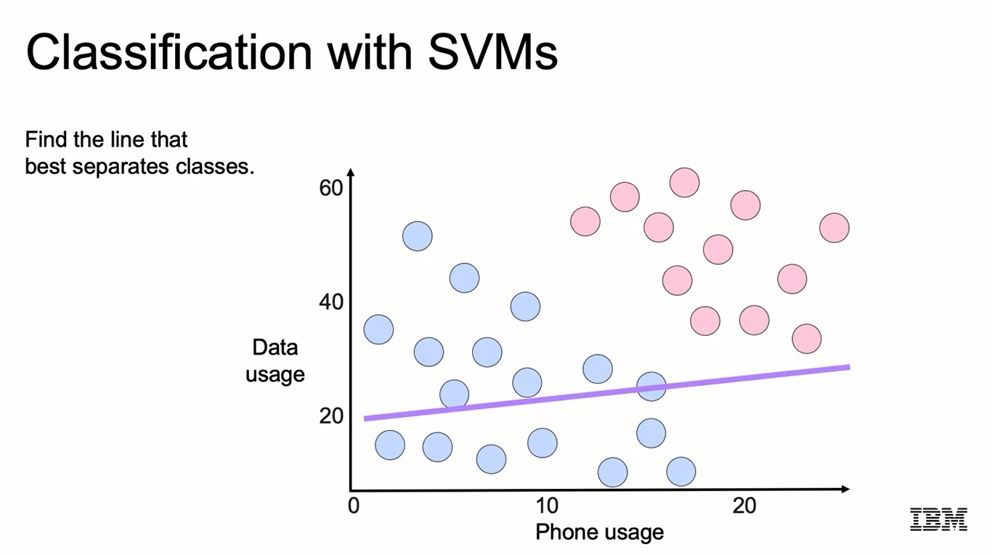
Classification with SVMs
19

Slide 21
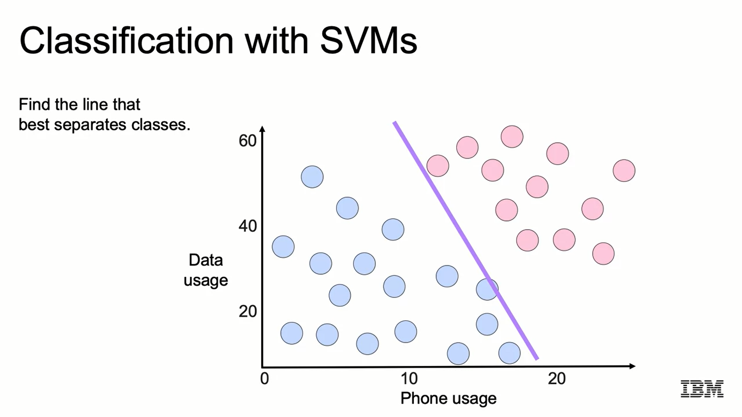
Classification with SVMs
20

Slide 22
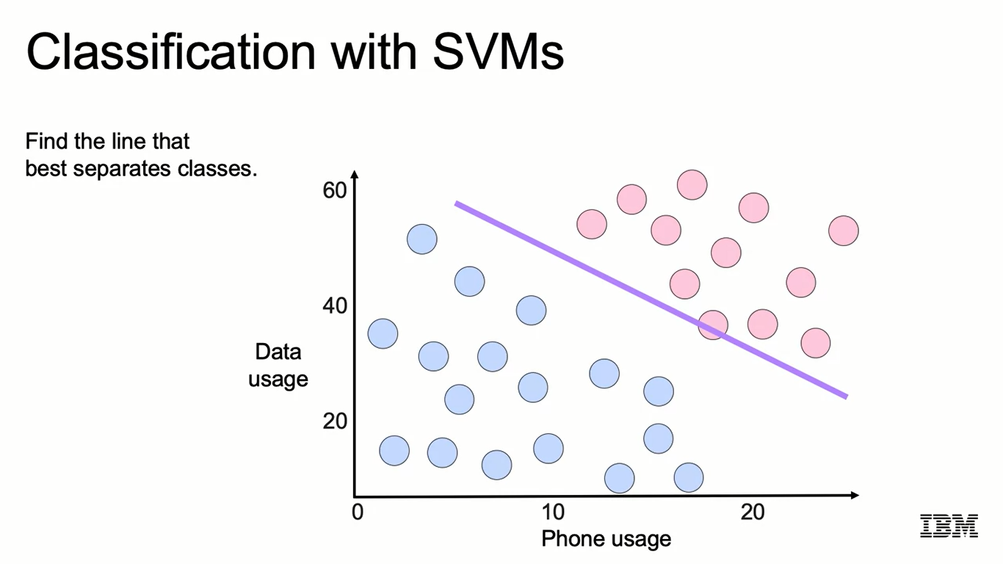
Classification with SVMs
21

Slide 23
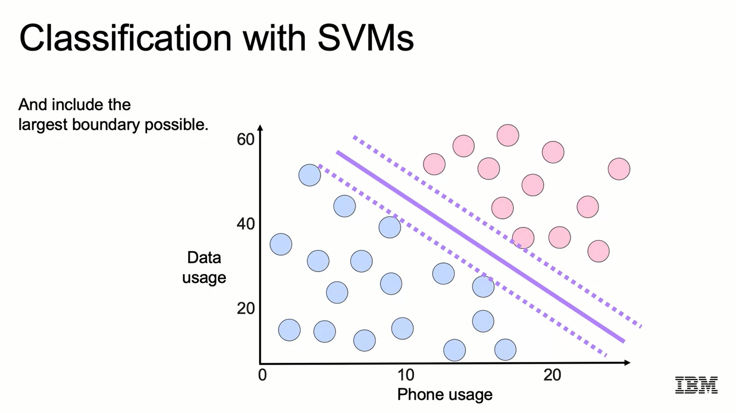
Classification with SVMs
22

Slide 24
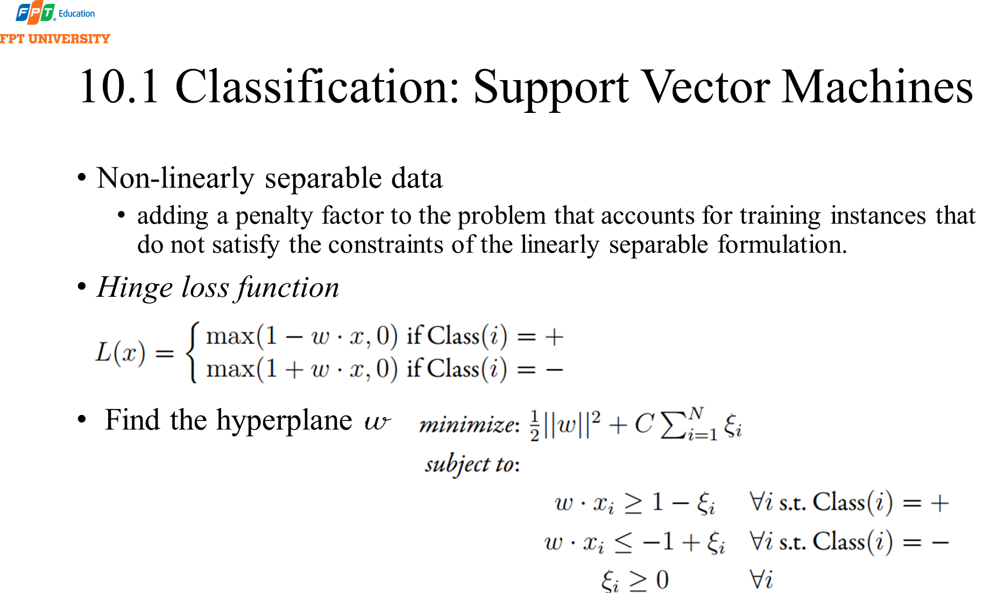
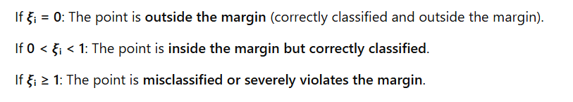

Slide 25
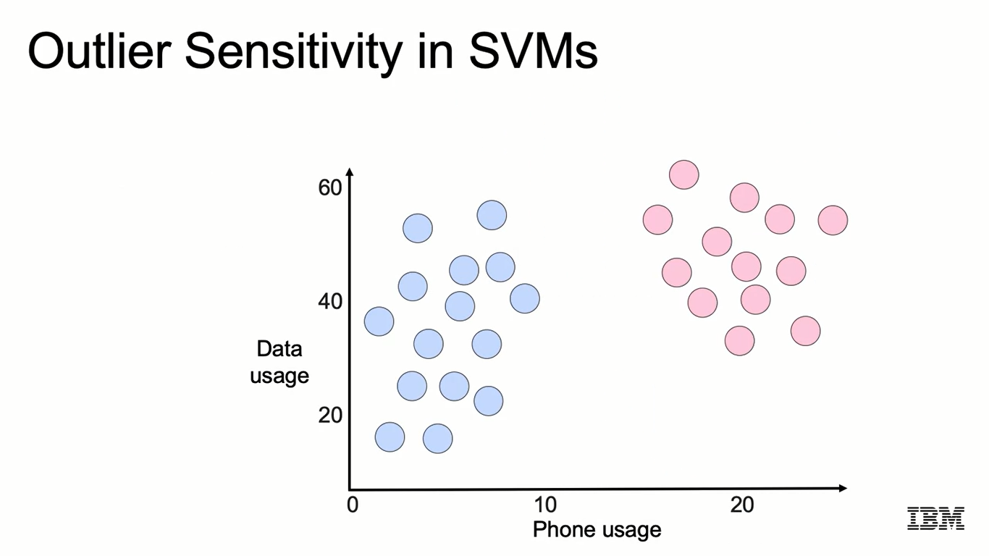
Outlier Sensitivity in SVMs
30

Slide 26
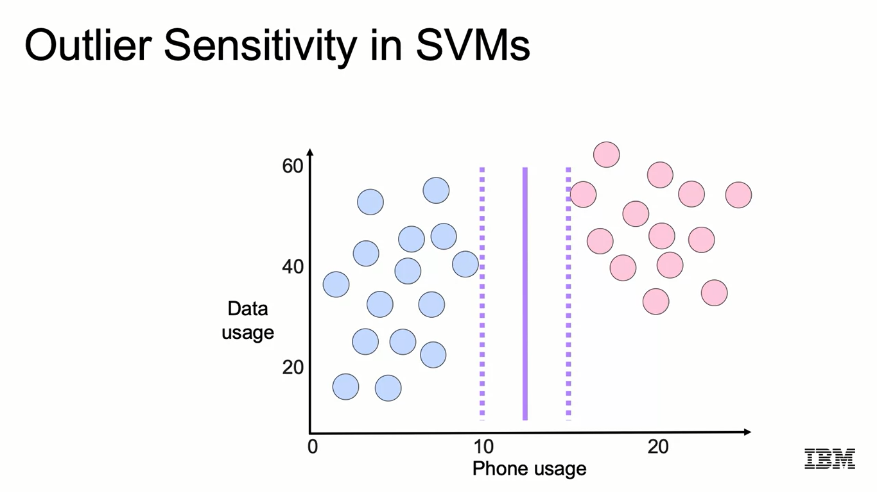
Outlier Sensitivity in SVMs
31

Slide 27
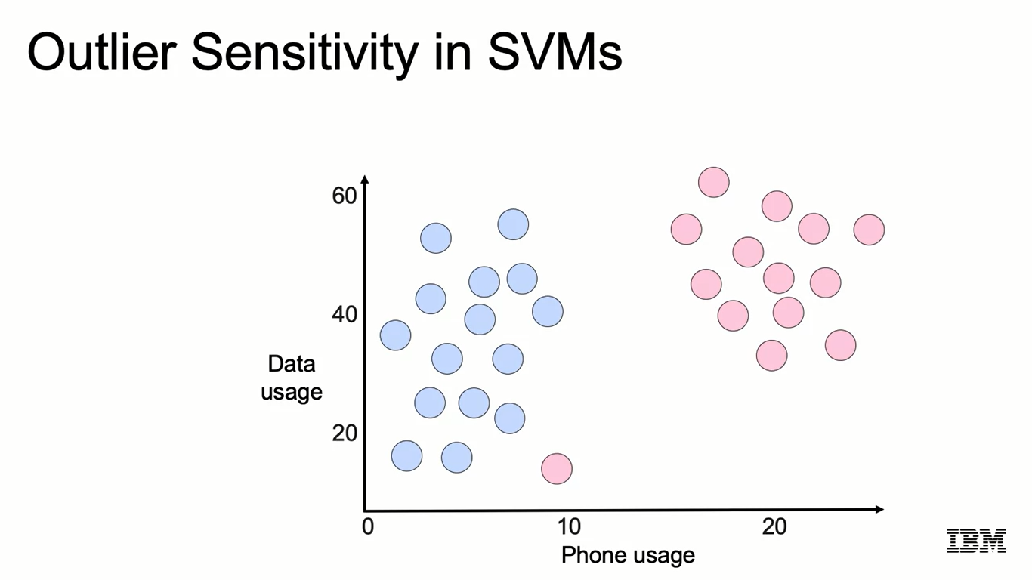
Outlier Sensitivity in SVMs
32

Slide 28
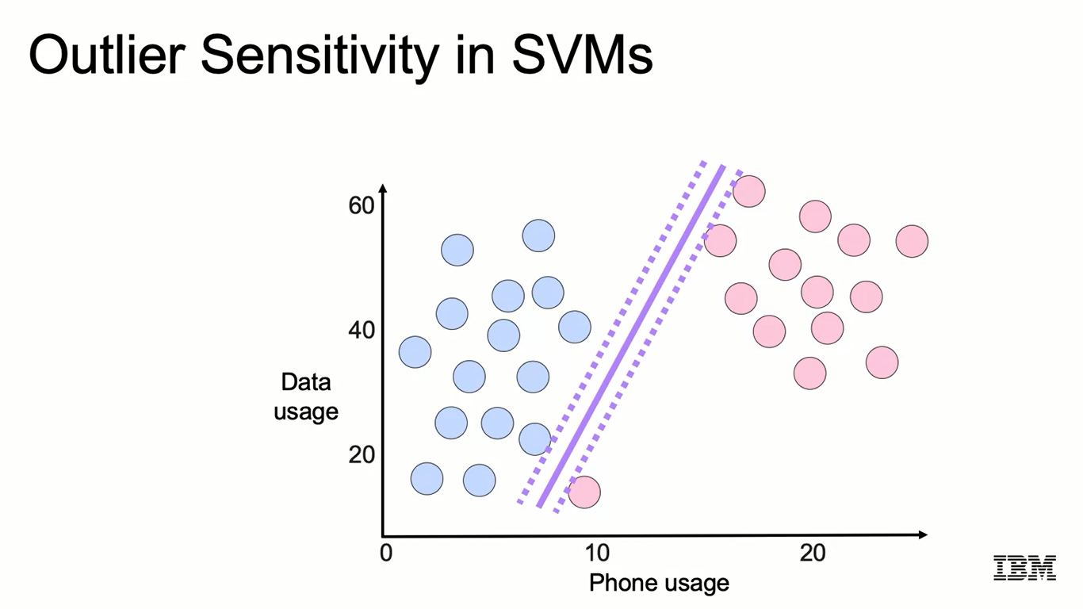
Outlier Sensitivity in SVMs
33

Slide 29
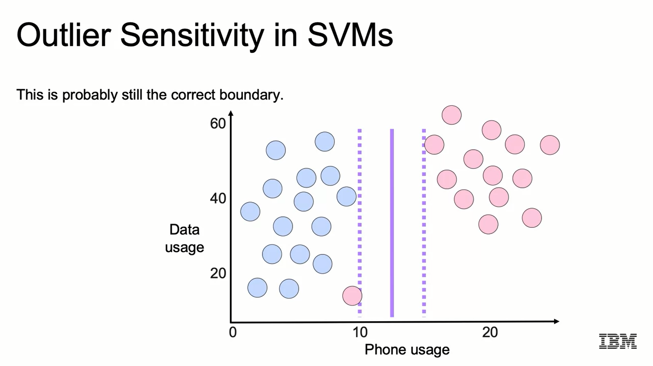
Outlier Sensitivity in SVMs
34

Slide 30

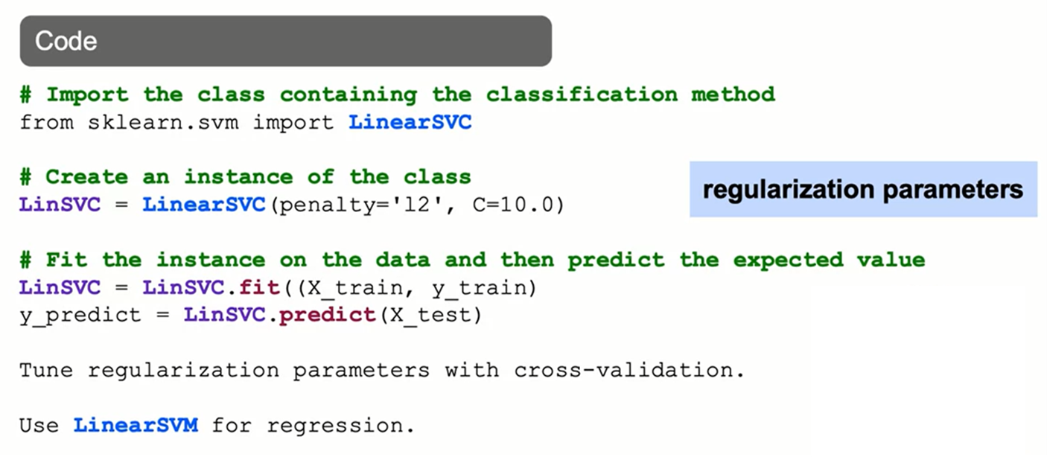

Slide 31



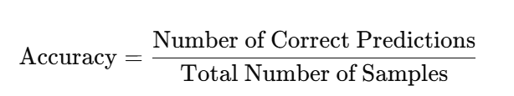
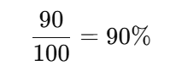

Evaluation
In machine learning, one of the most important tasks is classification. The goal of a classification model is to correctly assign labels to input data samples. However, after building the model, how do we determine whether it performs well?
Evaluating a classification model is crucial to understanding its effectiveness and identifying areas for improvement. The two most commonly used evaluation metrics are Accuracy and F-measure (F1-score).
Accuracy is the simplest metric, calculated as the ratio of correctly classified samples to the total number of samples:
For example, suppose we have a model that classifies emails as "Spam" or "Not Spam". If the model correctly classifies 90 out of 100 emails, the accuracy would be:For example, suppose we have a model that classifies emails as "Spam" or "Not Spam". If the model correctly classifies 90 out of 100 emails, the accuracy would be:

Slide 32

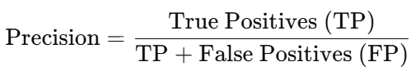
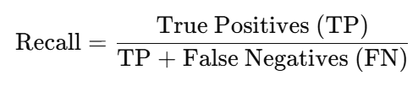
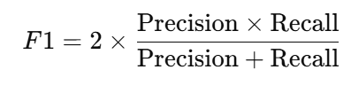
Evaluation
F-measure (F1-score) To address this issue, additional metrics such as Precision, Recall, and F1-score are used.
Precision (Positive Predictive Value) Precision measures the proportion of correctly predicted positive instances out of all instances predicted as positive.
Recall (Sensitivity or True Positive Rate) measures the proportion of actual positive instances correctly identified.
F1-score (Harmonic Mean of Precision and Recall) balances precision and recall. It is useful when there is an imbalance between the number of positive and negative samples..
Why use F1-score?
Accuracy can be misleading in imbalanced datasets, but F1-score accounts for both precision and recall.
F1-score is especially useful when both false positives and false negatives are undesirable.

Slide 33
Evaluation
When evaluating a classification model, it is important to recognize key differences between classification tasks and information retrieval (IR) tasks. The two major differences are:
The Concept of "Correctness"
In information retrieval (IR), a document is considered "relevant" if it is related to the user's search query.
In classification, a prediction is considered correct only if it exactly matches the actual label.
Example:
In Google Search, an article may be partially relevant to a query but not an exact match.
In email spam classification, an email can only be labeled as either "Spam" or "Not Spam."
Microaveraging in Classification Evaluation
In classification tasks, microaveraging is commonly used to aggregate Precision, Recall, and F1-score across all classes.
Microaveraging: Computes total True Positives (TP), False Positives (FP), and False Negatives (FN) across all classes before calculating Precision, Recall, and F1-score.
Macroaveraging: Calculates Precision, Recall, and F1-score for each class separately and then averages them.
Microaveraging is particularly useful in multi-class classification problems where class distributions may be imbalanced.

Slide 34
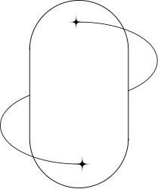
DEMO CODE

Slide 35
thank you
Presented by
Group 4

